Slide 1
Intellectual Property Disputes
https://www.smithsonianmag.com/history/ten-famous-intellectual-property-disputes-18521880/

Slide 2
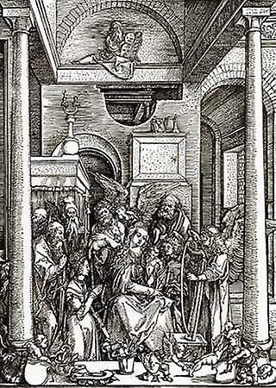
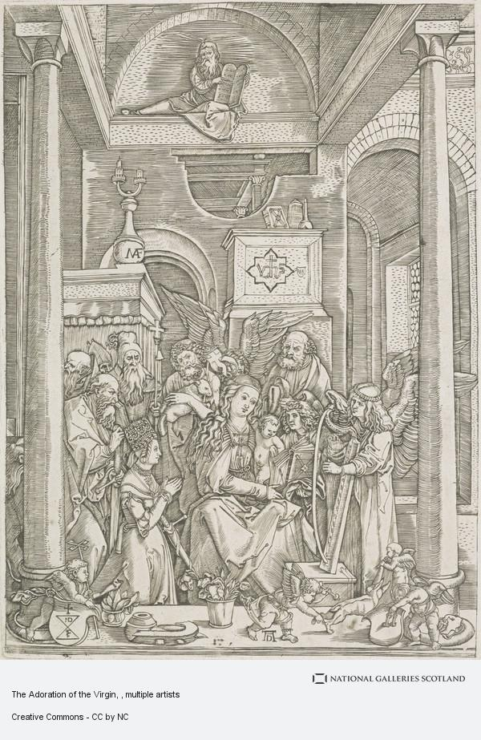
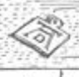
Copyright infringement is not new
Artist Albrecht Dürer discovered in the early 1500s that a fellow engraver by the name of Marcantonio Raimondi copied a woodcut series of engravings of his called the Life of the Virgin.
Student thoughts?

Slide 3
The prints, with Dürer’s “A” above “D” signature, passed of as Dürer originals, and Raimondi made considerable profits selling them.
Dürer brought his case to the court of Venice.
Ultimately, the court ruled that Raimondi could continue making copies, as long as he omitted the monogram signature.

Slide 4
Invention of Calculus
German Leibniz first published on the topic in 1684 and 1686.
Englishman Isaac Newton published the book Opticks in 1704, and asserted himself as the father of calculus.
Each of the thinkers’ respective countries wanted to stake a claim in what was one of the biggest advances in mathematics.
Newton wrote about the “science of fluxions,” in 1665 and 1666, but only shared his work with a few colleagues.
Newton accused Leibniz of plagiarizing an early draft.
Leibniz died in 1716 before anything was settled.
Today, Newton and Leibniz are credited co-inventors of calculus.

Slide 5
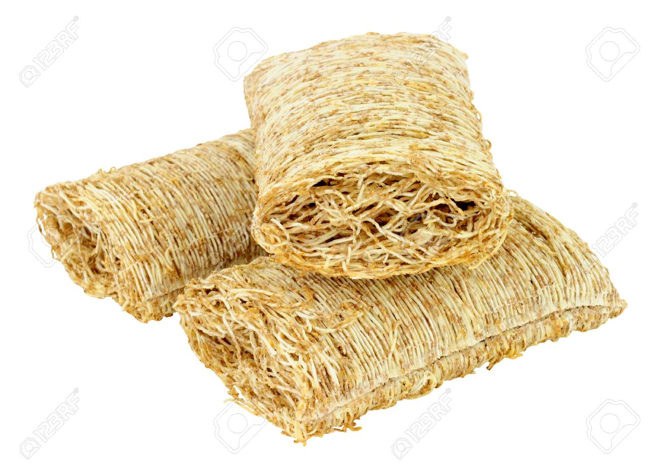
Shredded wheat

Slide 6
In 1893, Henry Perky made a pillow-shaped cereal he called “Shredded Whole Wheat”.
Critics called it “shredded doormat.” but it took off.
Perky died in 1908 and his two patents, on the cereal and machinery that made it, expired in 1912.
The Kellogg Company then made a very similar cereal.
In 1930.
The National Biscuit Company, a successor of Perky’s company, filed a lawsuit against the Kellogg Company, arguing that the new shredded wheat was a trademark violation and unfair competition.
Student thoughts?

Slide 7
OUTCOME:
Kellogg, in turn, viewed the suit as an attempt by NBC to monopolize the shredded wheat market.
In 1938, the case was brought to the Supreme Court, which ruled in favor of the Kellogg Company on the grounds that the term “shredded wheat” was not trademarkable, and its pillow shape was functional and therefore able to be copied after the patent had expired.

Slide 8
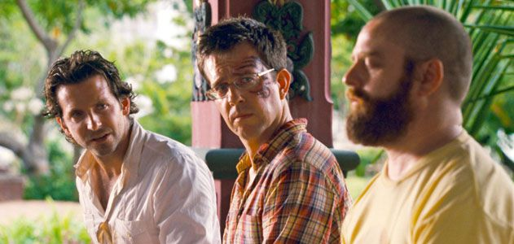
A Tattoo

Slide 9
In The Hangover Part II, the tattoo is identical to the one Mike Tyson has and alludes to the boxer’s cameo in the original 2009 movie.
Tattooist Whitmill filed a lawsuit against Warner Bros. Entertainment just weeks before the movie’s May 26 opening.
He had a copyright for the eight-year-old “artwork on 3-D” and said that the use of his design in the movie and advertisements without his consent was copyright infringement.
Warner Bros., of course, saw it as a parody falling under “fair use.”
What do you think?

Slide 10
On May 24, 2011 Chief Judge Catherine D. Perry of the United States District Court denied an injunction on the movie’s release.
But said Whitmill still had a case.
If it meant avoiding a long trial, Warner Bros. said, in early June, that it would be willing to “digitally alter the film to substitute a different tattoo on Ed Helms’s face” when the movie is released on home video.
Cost of each of these to Warner Bros.?
On June 17, Warner Bros. and Whitmill hashed out an agreement of undisclosed terms.

Slide 11
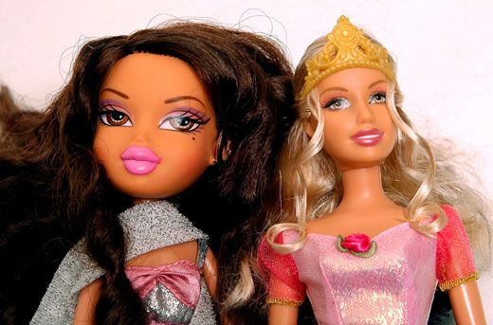
Mattel Inc. v. MGA Entertainment Inc

Slide 12
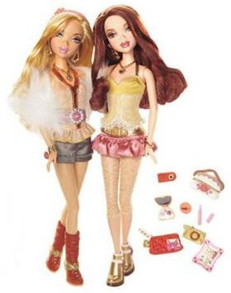
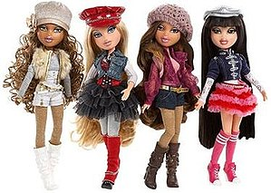
2001 Bratz seized 40 percent of Barbie’s market share in five years.
2005 Bratz maker MGA Entertainment filed a lawsuit against Mattel claiming that the line of “My Scene” Barbies copied the big-headed and slim-bodied physique of Bratz dolls.
What do you think?

Slide 13
Extra information
Mattel accused Bratz designer Carter Bryant of designing the doll while on Mattel’s payroll.
Bryant worked for Mattel from September 1995 to April 1998 and then again from January 1999 to October 2000, under a contract that stipulated that his designs were the property of Mattel.
Now what do you think?

Slide 14
In July 2008, a jury ruled in favor of Mattel, forcing MGA to pay Mattel $100 million and to remove Bratz dolls from shelves
(an injunction that lasted about a year).
In a later court case, MGA prevailed, proving that Mattel was actually the one to steal trade secrets.

Slide 15
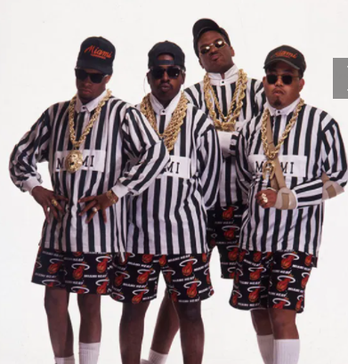
Rap group 2 Live Crew changed Roy Orbison’s hit from “pretty woman” to “big hairy woman,” “baldheaded woman” and “two-timin’ woman.”
Acuff-Rose Music Inc. objected.
But 2 Live Crew included the parody, titled
“Pretty Woman,” on its 1989 album
“As Clean as They Wanna Be” anyway.
Acuff-RMLtd claimed copyright infringement.
The case went to the Supreme Court, which,
said “Parody, or in any event its comment,
necessarily springs from recognizable allusion
to its object through distorted imitation,” Justice David Souter added
“Its art lies in the tension between a known original and its parodic twin.”

Slide 16

Authors Michael Baigent and Richard Leigh in 2004 claimed that Dan Brown had taken the “central theme” and “architecture” of their 1982 book “The Holy Blood and the Holy Grail” for his book the Da Vinci Code.
Baigent and Leigh’s book was nonfiction and Brown’s The Da Vinci Code was fiction.
Both books interpret the Holy Grail as being not a chalice but the bloodline of Jesus and Mary Magdalene, who they allege had a child together.
Baigent and Leigh accused Random House of copyright infringement.

Slide 17
A London court ruled, in 2006, that historical research (or “historical conjecture,” as was the case with The Holy Blood and the Holy Grail) is fair game for novelists to explore in fiction.
“It would be quite wrong if fictional writers were to have their writings pored over in the way The Da Vinci Code has been pored over in this case by authors of pretend historical books to make an allegation of infringement of copyright,” wrote Justice Peter Smith in his decision.

Slide 18
Politicians, journalists and scientists, in the mid-1980s, nicknamed the Reagan administration’s Strategic Defensive Initiative (SDI), the “star wars” program.
George Lucas’s production company did not want the public’s positive associations with the term to be marred by the controversial plan to place anti-missile weapons in space.
In 1985, Lucasfilm Ltd. filed a lawsuit against High Frontier and the Committee for a Strong, Peaceful America—two public interest groups that referred to SDI as “star wars” in television messages and literature.
Lucasfilm Ltd. had a trademark for Star Wars.

Slide 19
The federal district court ruled in favour of the interest groups and their legal right to the phrasing so long as they didn’t attach it to a product or service for sale.
“Since Jonathan Swift’s time, creators of fictional worlds have seen their vocabulary for fantasy appropriated to describe reality,” read the court decision.
Still with Lucas Films…

Slide 20
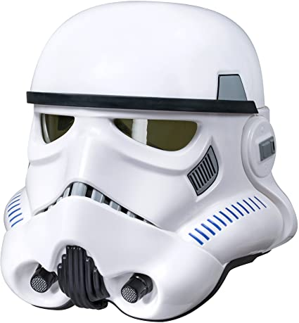
Mr Ainsworth designed the helmets used by storm troopers in starwars.
Once they’d been included in the films,
he reproduced and sold them himself.
Lucasfilm claimed copyright infringement,
as Ainsworth had created the designs
while employed by Lucasfilm,
so the trademark therefore belonged
to his employer.

Slide 21
The court held that the storm trooper helmet is functional rather than artistic.
This meant that it was unable to be protected by copyright, so there was no infringement

Slide 22
In 1999, Shawn Fanning, created Napster, a peer-to-peer music sharing service that allowed users to download MP3s for free.
A&M Records, part of Universal Music Group, accused Napster of contributory and vicarious copyright infringement.
In the United States Court of Appeals Napster was found guilty on both counts. In 2002, Napster was shut down.
Grokster, another music-sharing site, continued for a few more years, but stopped operating when the Supreme Court ruled against it in MGM v. Grokster in 2005.

Slide 23
In 1994, Adidas had used its three-stripe mark as a logo since 1952 and registered it as a trademark.
Payless was selling confusingly similar athletic shoes with two and four parallel stripes.
The two companies agreed a settlement.
2001 Payless was again selling the look-alikes.
Adidas America Inc. demanded a jury trial. The trial lasted seven years, during which 268 pairs of Payless shoes were reviewed.

Slide 24
Adidas was awarded $305 million—$100 million for each stripe, as the Wall Street Journal’s Law Blog calculated
Interesting interpretation of original
Apple v Xintong Tiandi (2016)
Apple took a Chinese company to court for the use of the word “iPhone”. The Chinese company were already using the word “iPhone” on their products – handbags, phone cases and other leather goods.

Slide 25
Apple lost their case.
They were unable to prove that they were a well-known brand in China before Xintong Tiandi filed their trademark application in 2007.
The Apple iPhone went on sale in China in 2009.

Slide 26
A Chinese sportswear company was using the name Jordan (written in characters and read as Qiaodan in Chinese) on its sportswear.
Michael Jordan didn’t agree to the company using his name in their branding and was not affiliated with them in any way. He took them to court to dispute their trademarks and to protect his name.
The court agreed that the company shouldn’t be allowed to use Jordan’s Chinese name.
However, they can still use the Romanised version of it, pronounced as “Chee-ow-dahn”.

Slide 27
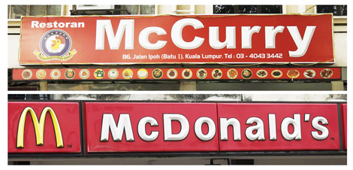
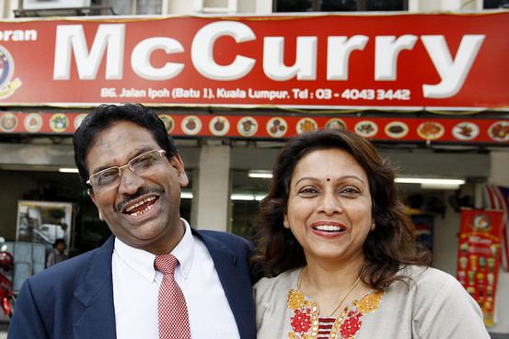

In Malaysia, a small curry restaurant called “McCurry” was taken to court by McDonald’s for trademark infringement.

Slide 28

The first court ruled in favour of McDonald’s, agreeing that there was trademark infringement.
McCurry appealed the decision, and
the appeal court overturned the initial
judgment, stating there was no trademark
infringement.
McDonald’s appealed to the Malaysian
federal court.
The Malaysian federal court approved the appeal decision on the basis that McDonald’s did not properly frame its questions when applying to challenge the appeal court’s decision.

